Slide 1


etflix
Data Analysis
Understanding Viewer Preferences and Performance
-By Sakshi Yadav

Slide 2

Introduction
2. Objectives and Scope
Content Table
3. Workflow
4. Data Collection and Loading
5. Data Cleaning
6. Data Analysis
7. Insights and Results

Slide 3


Introduction
This project focuses on analyzing Netflix data to uncover viewer behaviors and content trends.
By refining data types, resolving inconsistencies, and leveraging SQL queries, the analysis aims to provide actionable insights for optimizing content strategies and enhancing user experience on the platform.

Slide 4



Objectives
Enhance Data Quality and Consistency
Deepen Understanding of Viewer Preferences
Optimize Operational Efficiency
Drive Strategic Decision-Making
Scope
Enhance Data Quality and Consistency Deepen Understanding of Viewer Preferences Optimize Operational Efficiency Drive Strategic Decision-Making

Slide 5



Workflow
Data Collection and Loading
Data Cleaning and Transformation
Data Storage and Management
Data Analysis and Insights

Slide 6
Data Collection and Loading
Data Sources
Netflix dataset containing information about movies, TV shows, directors, cast, genres, countries, duration, and ratings.
Data Loading Process
Data was initially loaded into Python for preprocessing and then imported into the raw data layer of SQL Server.

Slide 7


DATA CLEANING

Slide 8
Enhancements in Netflix Data Table
Changed Data Type of Title Column
Converted ‘title’ column from ‘varchar’ to ‘nvarchar’ to support foreign characters.
Ensured visibility and correct representation of all characters in titles.
Adjusted Column Lengths
Determined optimal column lengths using Python to improve loading speed.
Changed from max length to required length for efficient data handling.
Set Primary Key for show_id
Identified ‘show_id’ as unique across the dataset.
Established ‘show_id’ as the primary key to ensure data integrity and uniqueness.

Slide 9

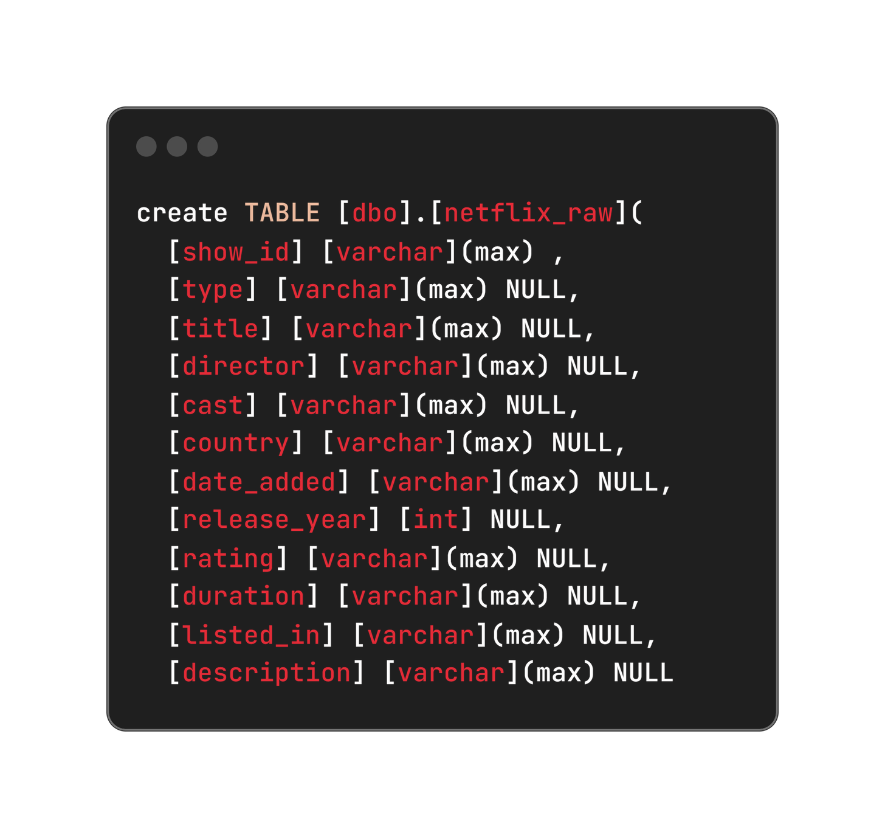
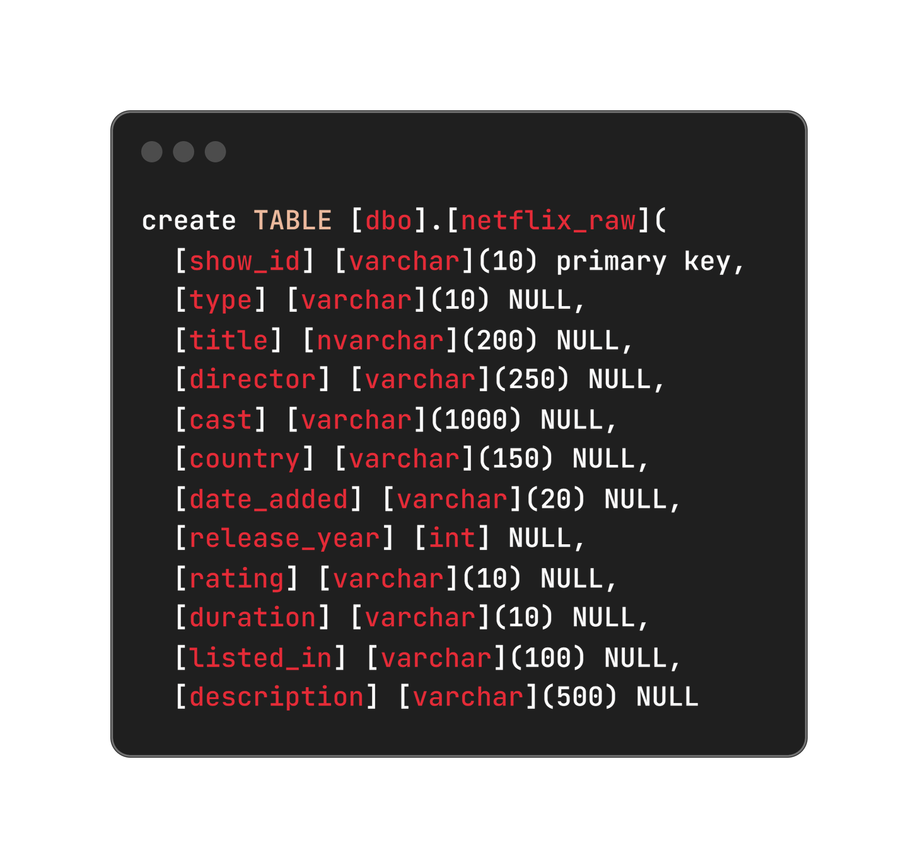

DATA CLEANING

Slide 10
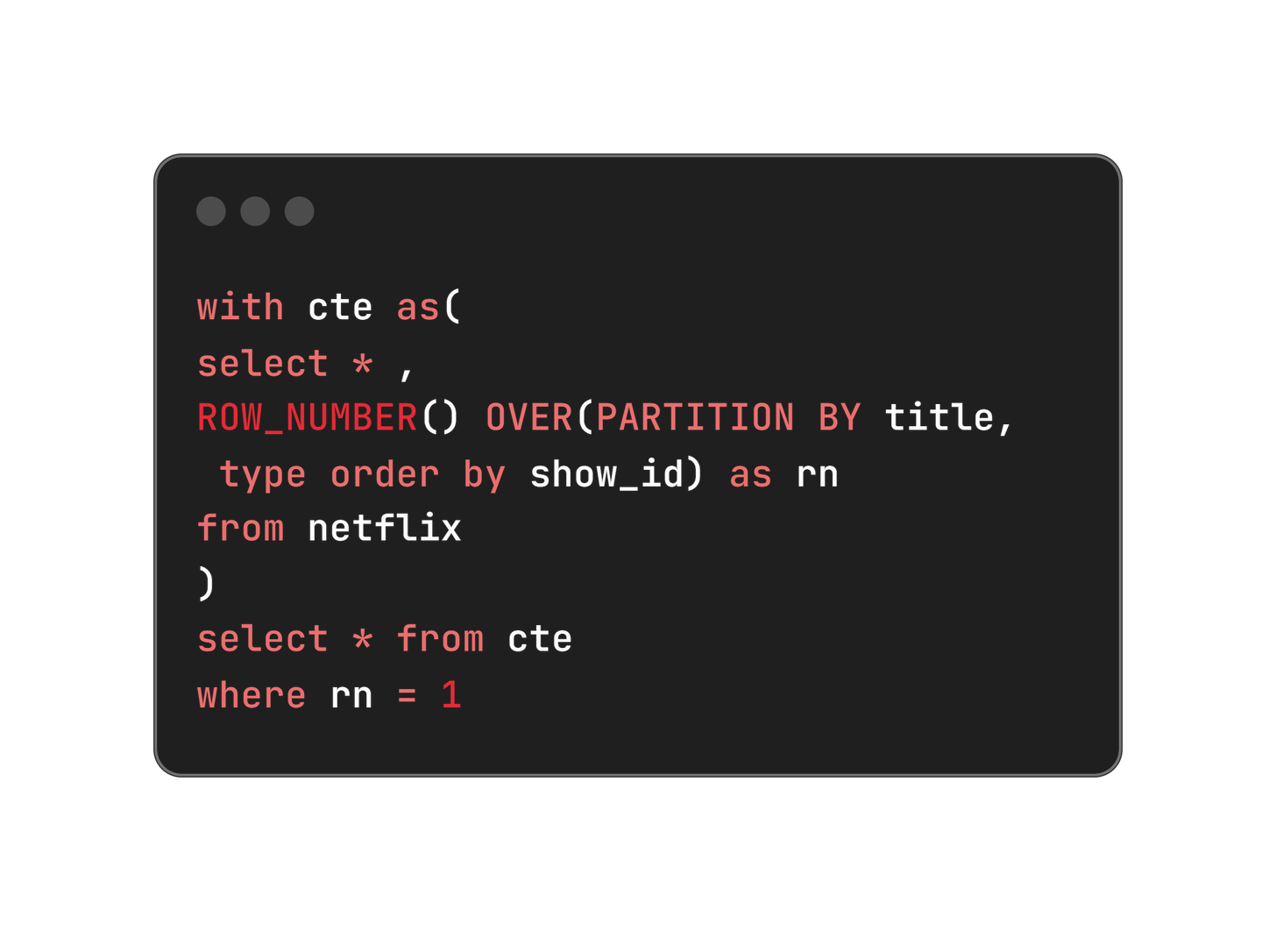
2. Remove Duplicates
This SQL query efficiently selects only unique rows for each title in the Netflix data table by assigning row numbers partitioned by title, thereby ensuring duplicates are handled appropriately.

Slide 11
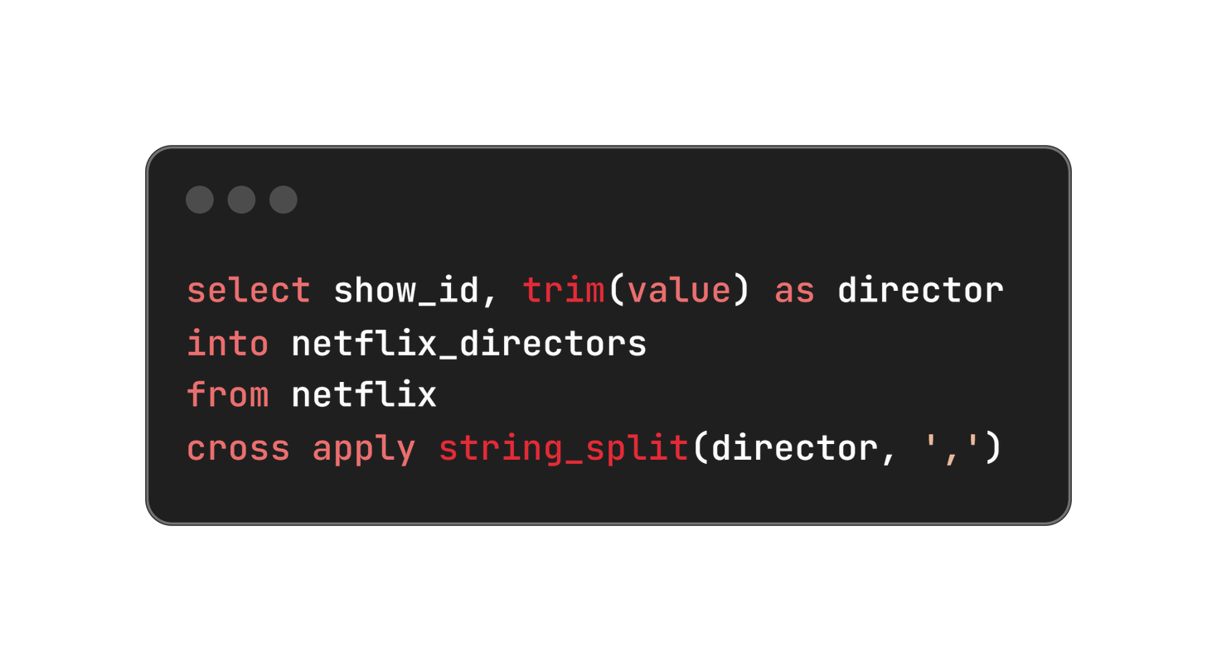
3. Refactoring Columns with Multiple Values into Separate Tables
To improve data structure and normalization, columns containing multiple values separated by commas were refactored into separate tables. This enhances data integrity and allows for more efficient querying and analysis of individual values.

Slide 12
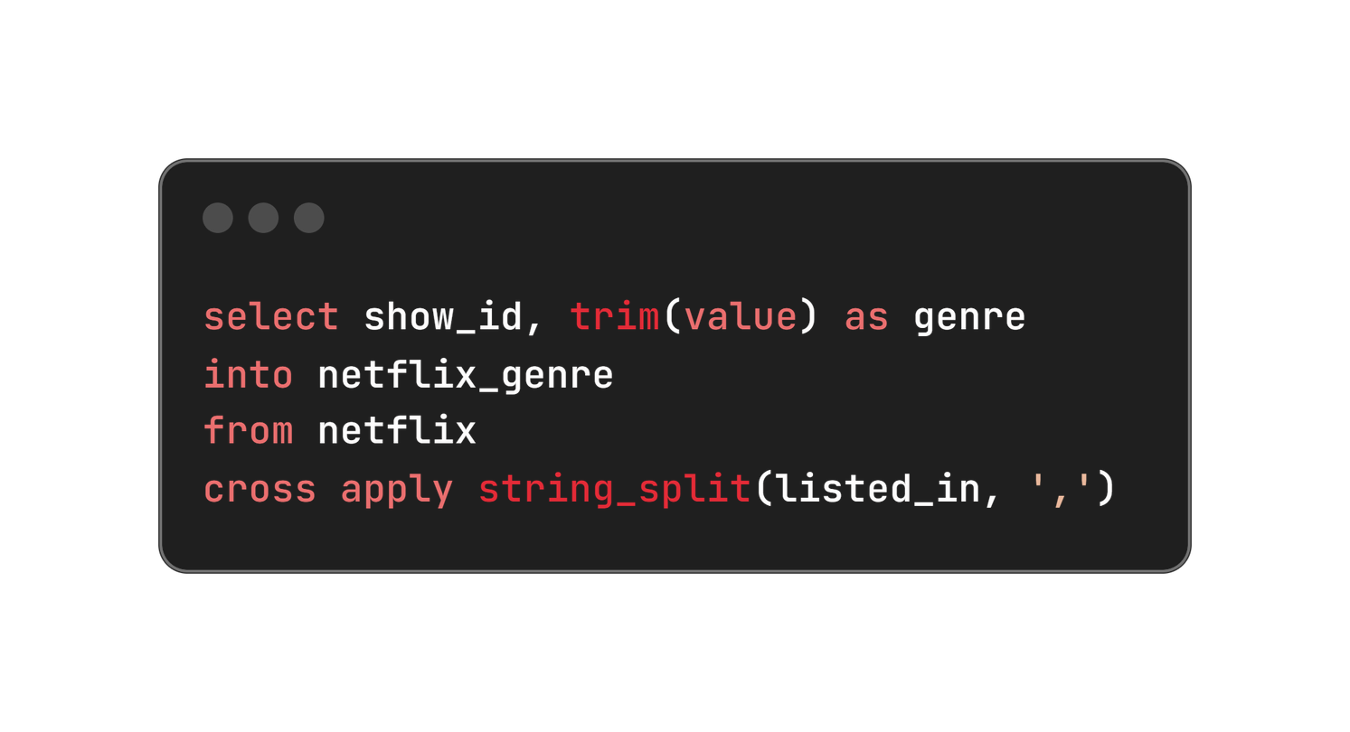
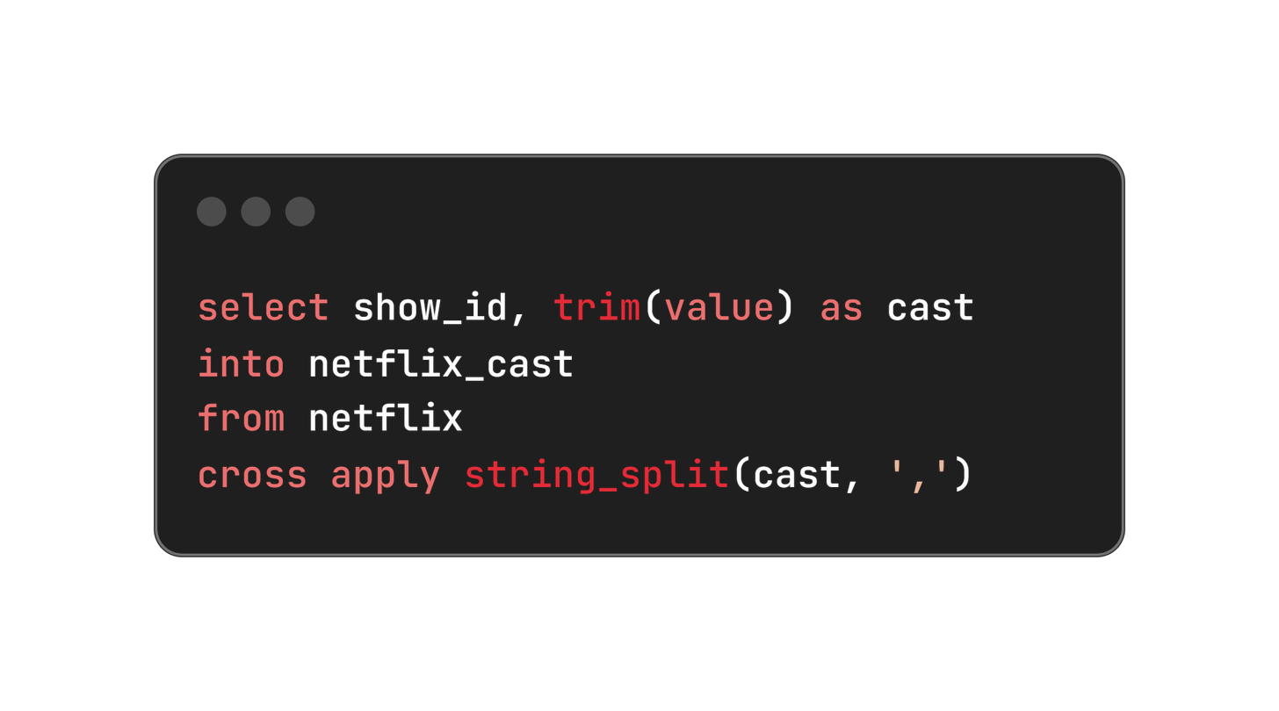
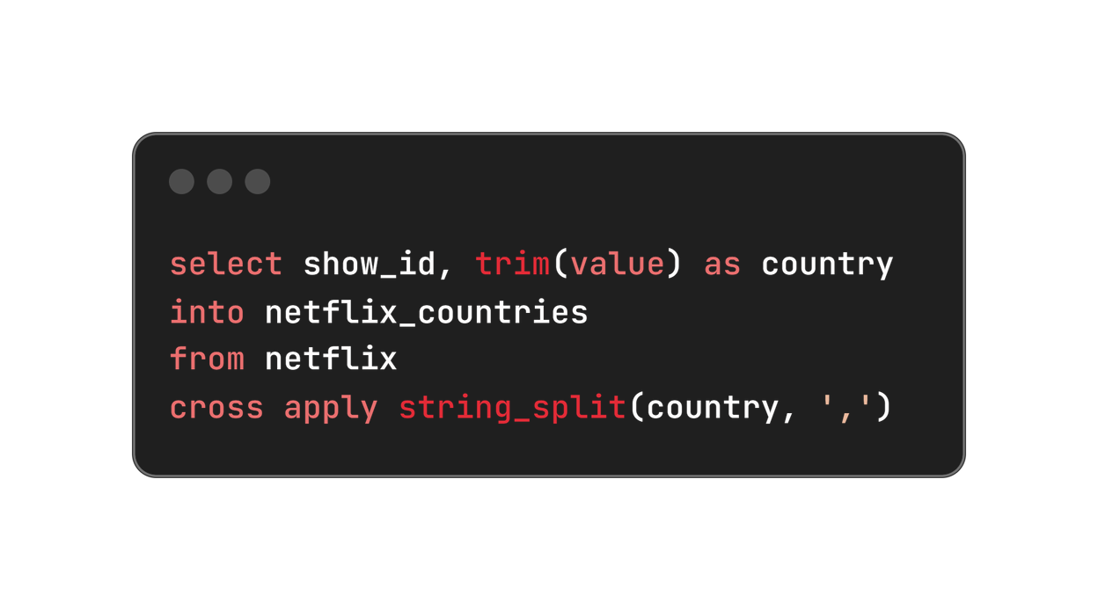

Slide 13
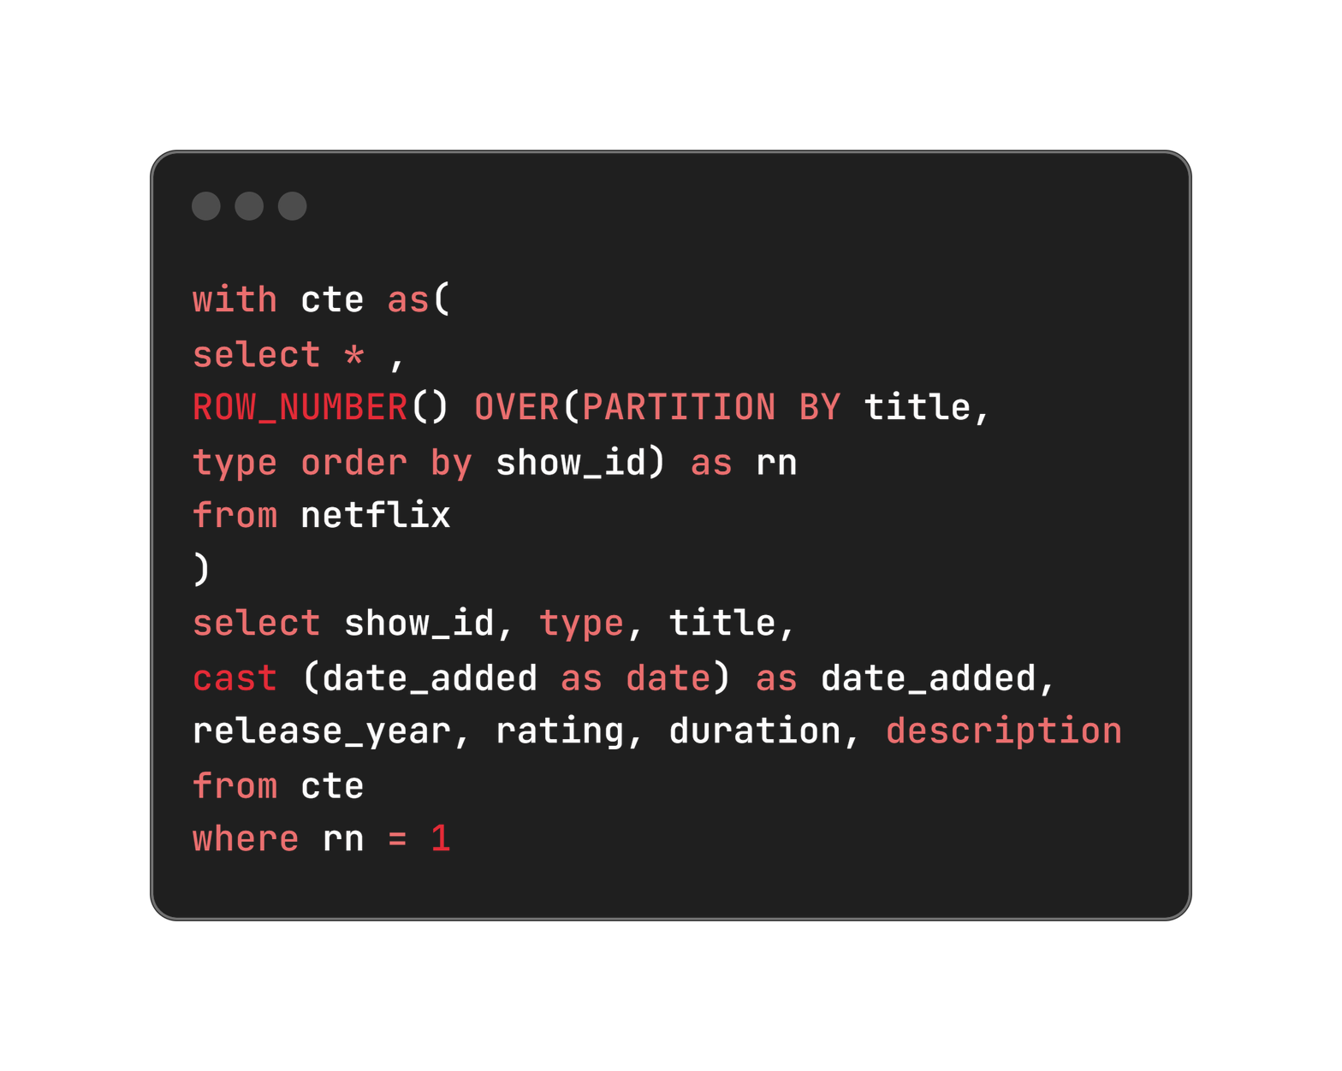
4. Data type conversions for date added
The data type of the "Date Added" column was changed from varchar to date to enhance data consistency and facilitate accurate date handling.

Slide 14

5. Populating missing values in Country Column
Null values in the "Country" column were filled by analyzing the "Director" column, assuming that directors typically create content in their own country.
This approach improves data completeness and enhances geographical insights within the dataset.

Slide 15
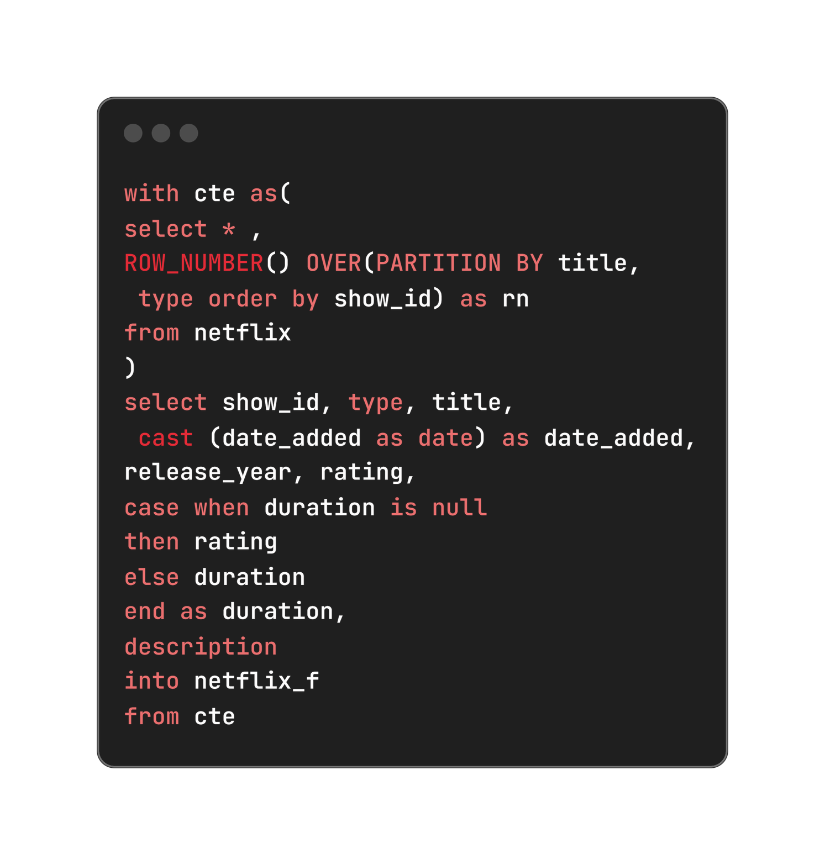
6. Populating missing values in Duration Column
An issue was identified where null values in the "Duration" column were incorrectly placed in the "Rating" column. This discrepancy was resolved using a ‘CASE’ statement, ensuring that each column contains the appropriate data without compromising data integrity or analysis accuracy.

Slide 16
DATA ANALYSIS

Slide 17
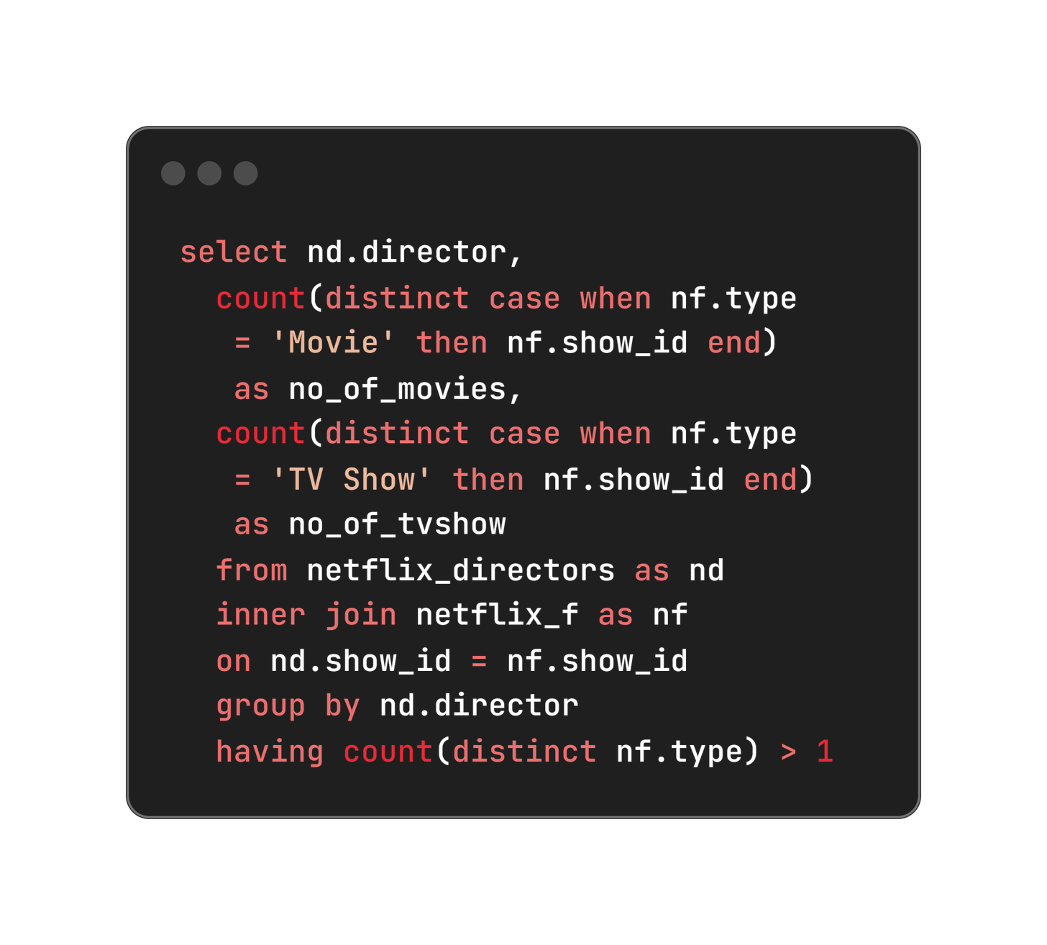
For each director count the number of movies and tv shows created by them in separate columns for directors who have created tv shows and movies both

Slide 18
Top 6 rows of the Output table
Director | No. of Movies | No. of TV Shows
Abhishek Chaubey | 4 | 1
Alastair Fothergill | 1 | 3
Alban Teurlai | 1 | 1
Alessandro Angulo | 1 | 1
Andrew Tan | 1 | 1
Anurag Kashyap | 8 | 1

Slide 19
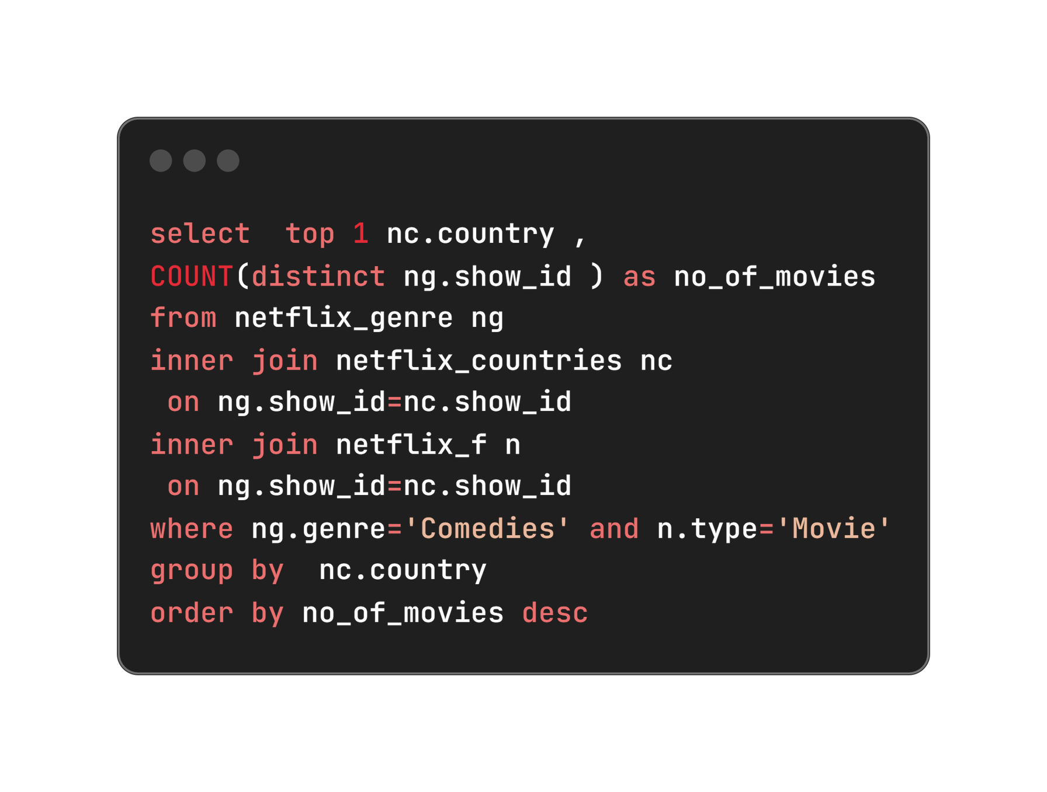
2. Which country has highest number of comedy movies
Country | No. of Movies
United States | 685

Slide 20
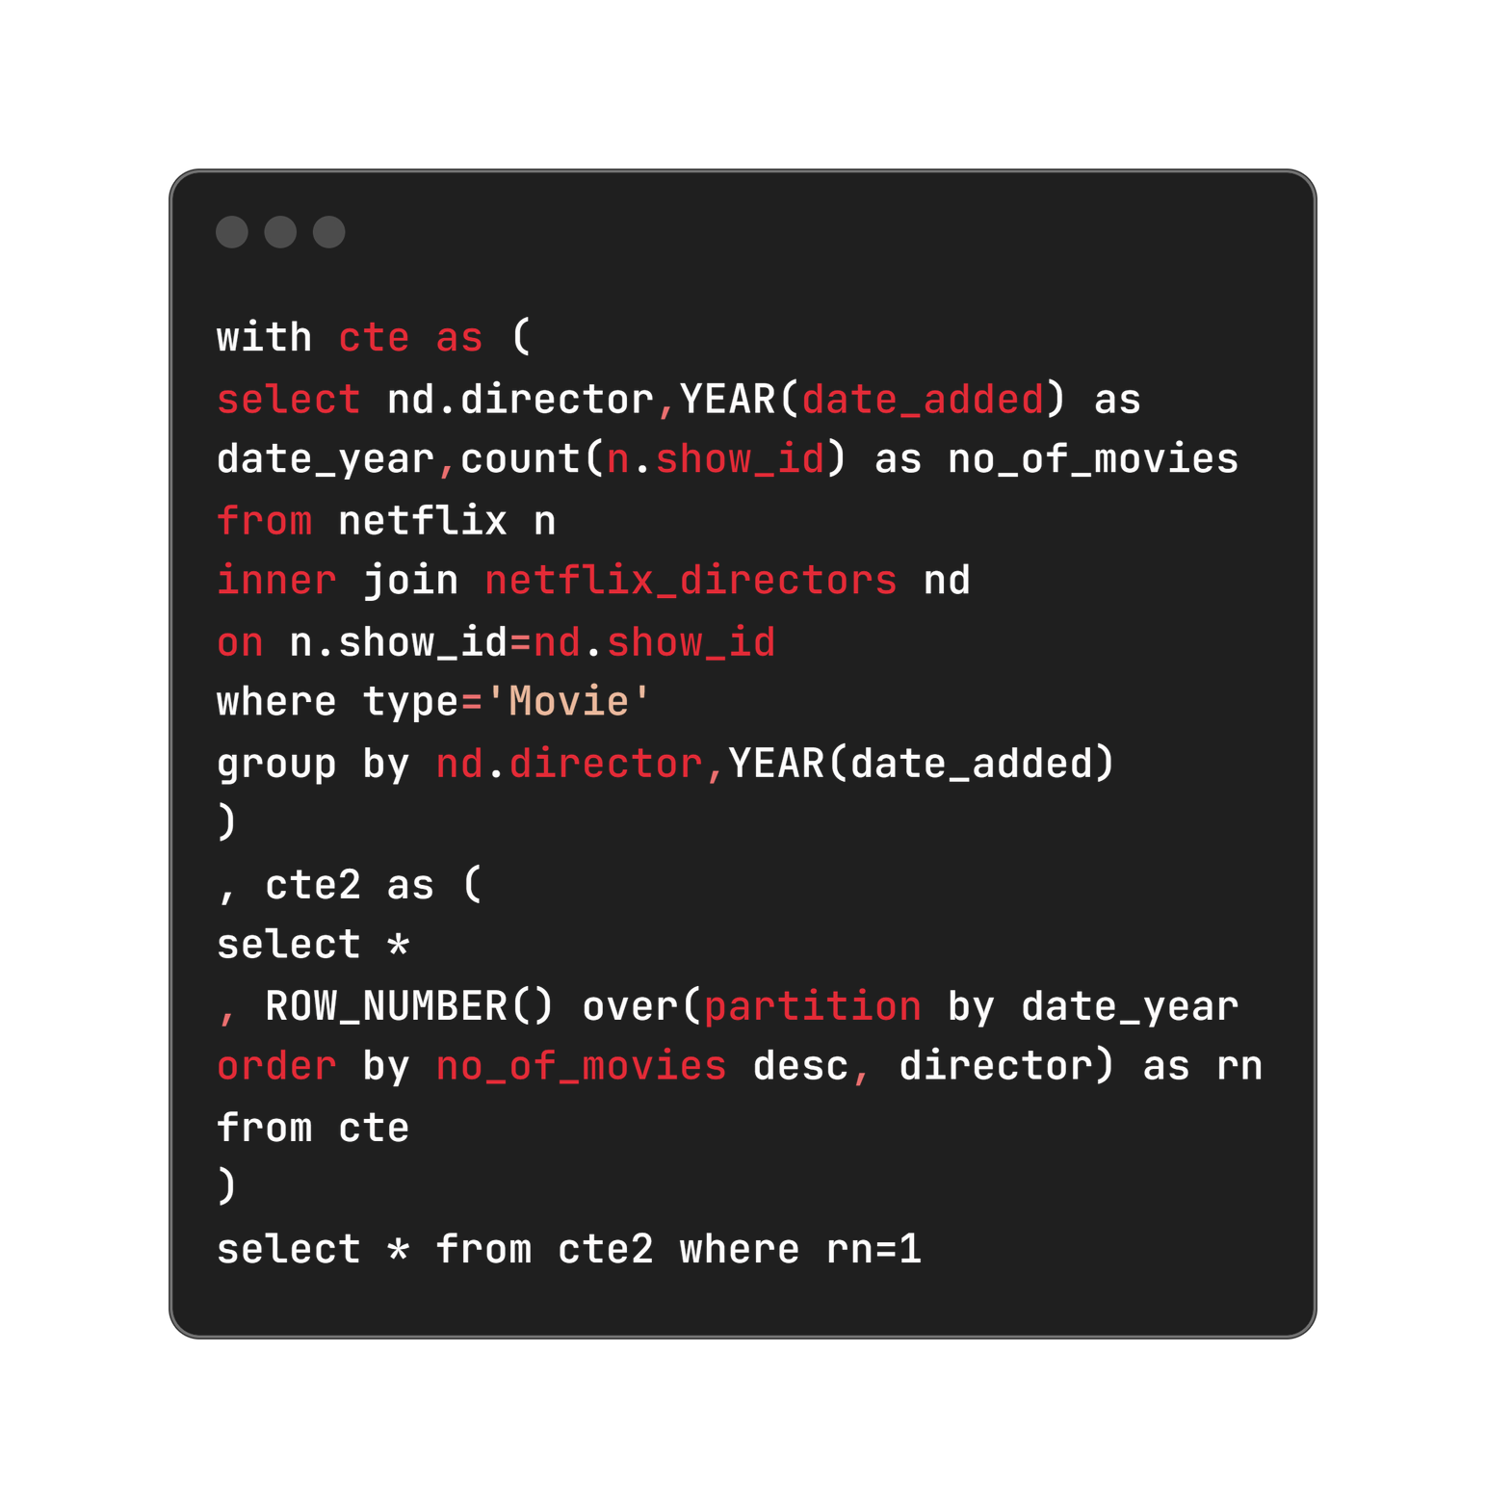
3. For each year (as per date added to netflix), which director has maximum number of movies released

Slide 21
Last 6 rows of the Output table
Director | Year | No. of Movies
Jan Suter | 2016 | 4
Jay Chapman | 2017 | 7
Jan Suter | 2018 | 12
Cathy Garcia-Molina | 2019 | 7
Youssef Chahine | 2020 | 11
Rajiv Chilaka | 2021 | 17

Slide 22


Directors with highest number of movies in respective year

Slide 23
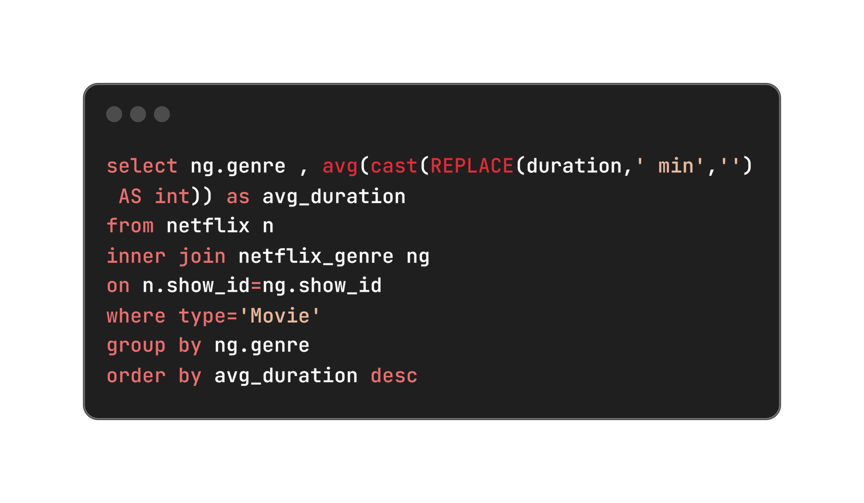
4. What is the average duration of movies in each genre

Slide 24

Top 5 movies with highest average duration time in minutes

Slide 25
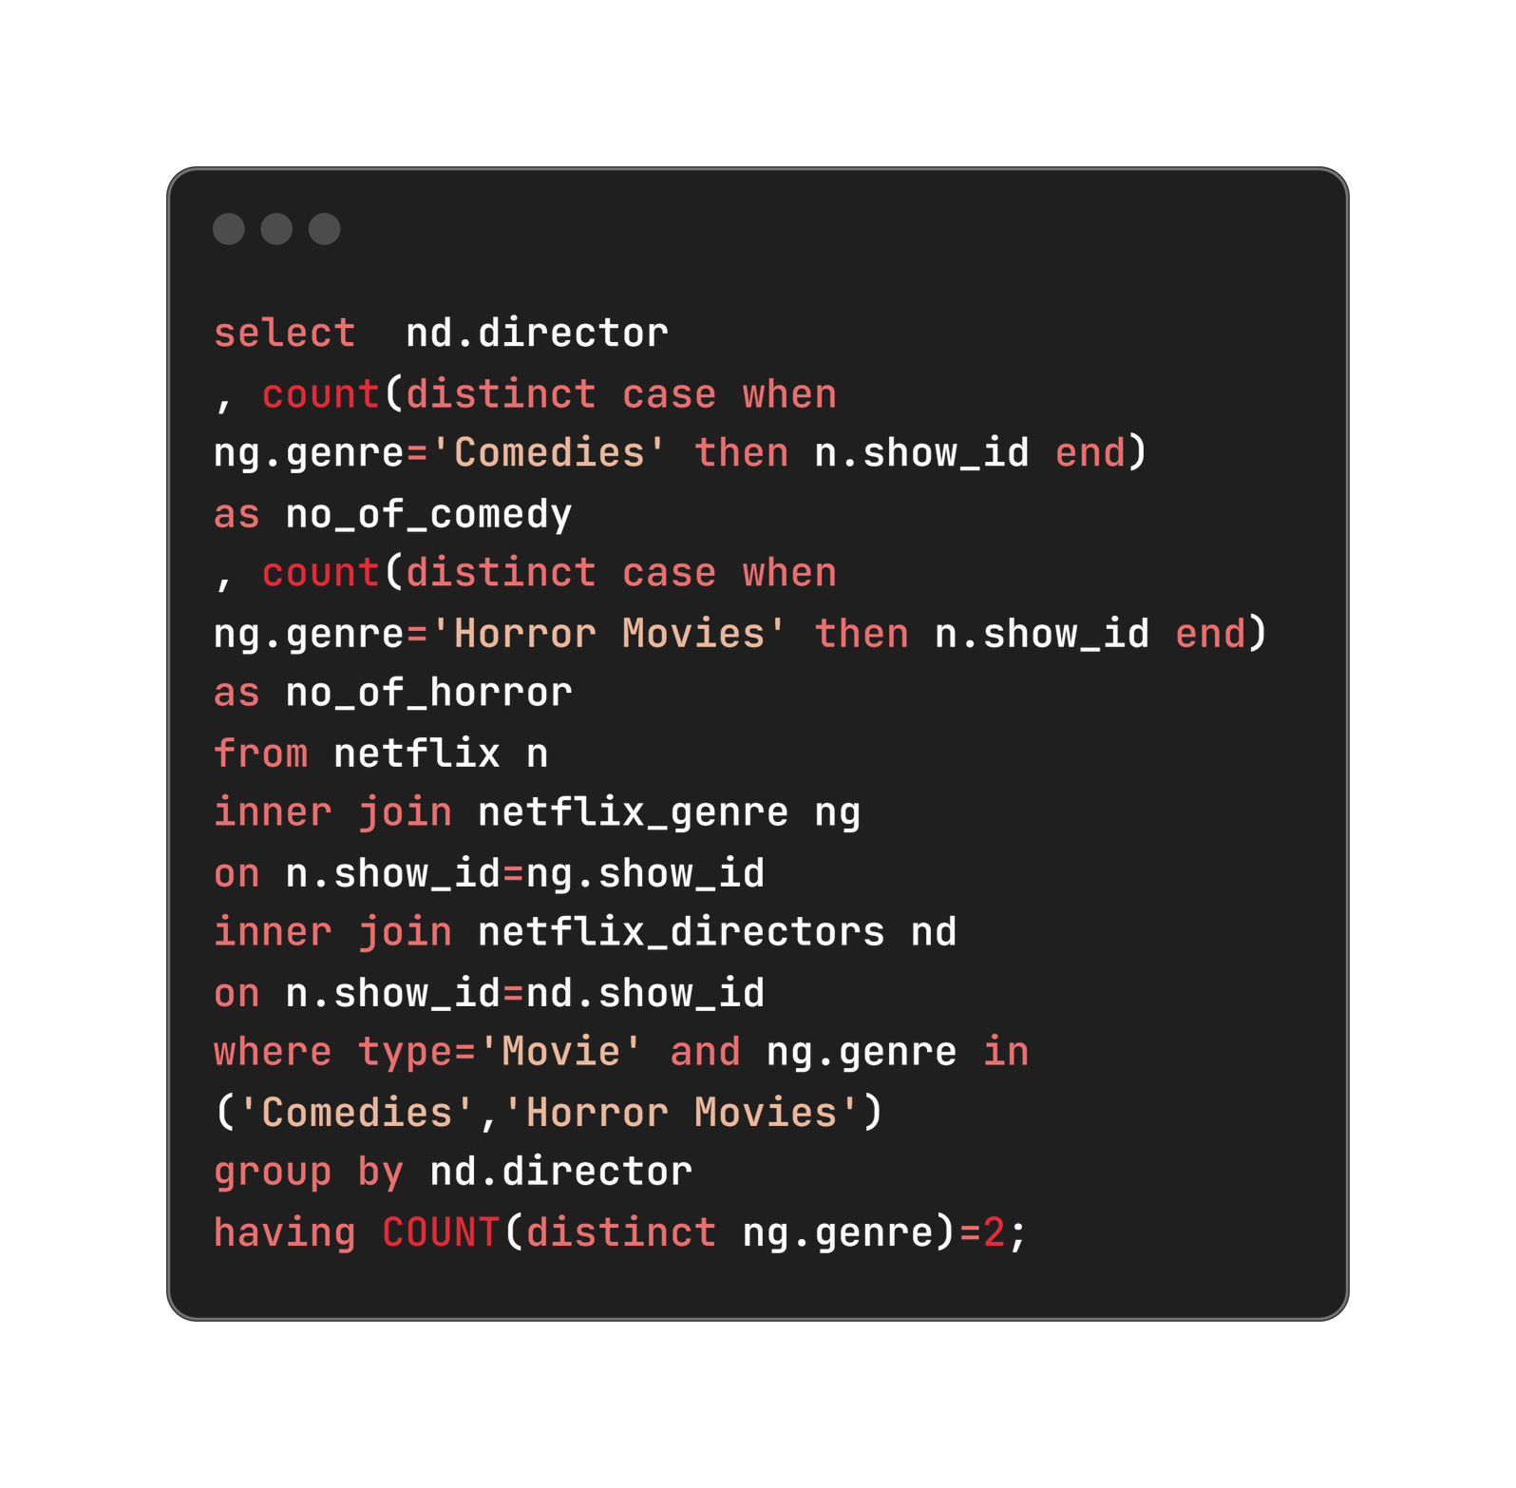
5. Find the list of directors who have created horror and comedy movies both.
Display director names along with number of comedy and horror movies directed by them.

Slide 26
6 random rows from the output table
Director | No. of Comedy | No. of TV Horror
Banjong Pisanthanakun | 1 | 3
Don Michael Paul | 3 | 3
Jeff Baena | 2 | 1
Kevin Smith | 5 | 3
Michael Tiddes | 4 | 2
Poj Arnon | 3 | 5

Slide 27
Insights and Results

Slide 28
Key Findings
Content Preferences: Highlighted the popularity of comedy movies in the United States, guiding localized content acquisition strategies.
Directorial Excellence: Recognized prolific directors and their impact on Netflix’s content diversity and viewer engagement.
Genre Analysis: Provided insights into viewer preferences based on genre and average duration, informing content curation strategies.

Slide 29
Business Impact
Enhanced Content Relevance:
Targeting popular genres like comedy in the United States improves viewer engagement.
2. Strategic Partnerships
Collaborating with top directors diversifies content and attracts broader audiences.
3. Operational Efficiency
Optimizing content length enhances viewer satisfaction and retention.
4. Informed Decision-Making
Data-driven insights enable precise resource allocation and competitive positioning.

Slide 30

Thank you!
For exploring this presentation on the Netflix data analysis project. Your interest and engagement are greatly appreciated as we continue to uncover valuable insights from the data.

